Slide 1


JESUS FILM HARVEST PARTNERS
To give every person an opportunity to hear about Jesus Christ.
Notes:
Thank you for being here today!
I want to take a minute to tell you why I am so invested with JESUS Film Harvest Partners.
- I became involved as a Harvest Partner… (date, person who initiated your involvement, story…)
- I remain involved because… (good use of my time, I know this makes a difference…)
- Please receive my appreciation for your part in this movement of God.

Slide 2
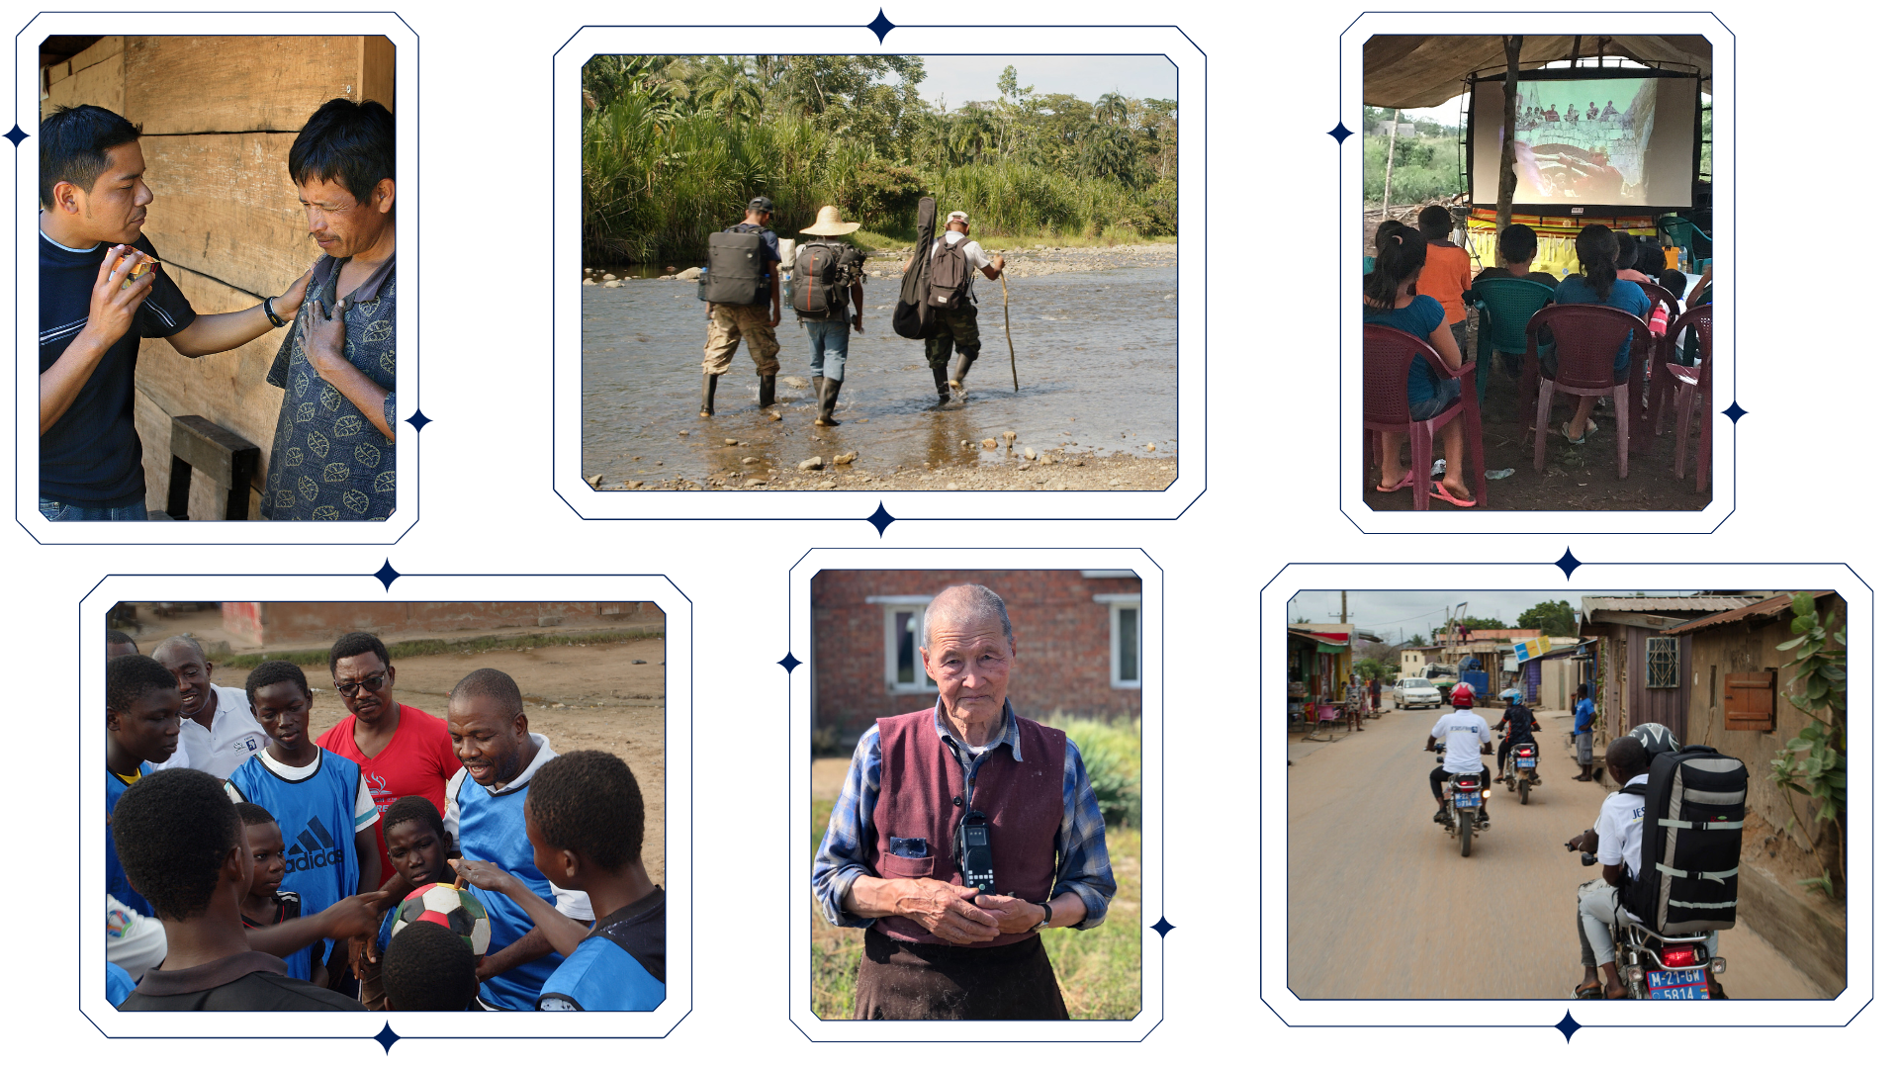
Notes:
JESUS Film Harvest Partners is a Kingdom-building ministry devoted to world evangelism through the JESUS film and other tools.
Harvest Partners equip and support JESUS Film teams of local people to do evangelism, discipleship, and church planting.

Slide 3



JESUS Film teams
countries
languages
1,166
65
212
Notes:
Before I get into how you can get involved in the ministry, I want to share a little about what God has done through JESUS Film teams over the last 25 years as well as this past quarter.
This year, 1,166 teams are working in 65 countries around the world, sharing the gospel in 212 languages!

Slide 4




94 million +
evangelistic contacts
19.3 million +
decisions for Christ
9.5 million +
discipleship follow-ups
140,000 +
Preaching Points
Notes:
Over the life of the ministry, JESUS Film teams have reported…
Over 94 million evangelistic contacts
More than 19.3 million people have made decisions for Christ
9.5 million new believers discipled
And over 140, 000 Preaching Points have been planted

Slide 5

Notes:
Let’s break these numbers down to give you some perspective.
In the last 90 days, 61,690 people made decisions for Christ
That’s enough to fill an average NFL stadium!

Slide 6
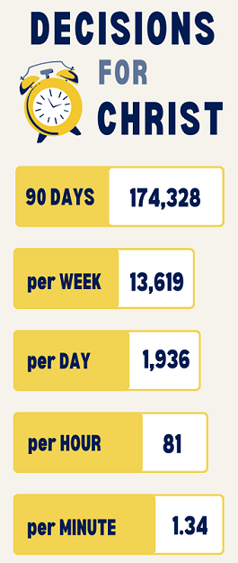
Notes:
The stats pictured break this number down by week, day, hour, and minute.
That equates to
13,619 per week
1,936 per days
81 per hour
1.34 per minute
Doesn’t that put a new perspective on making every moment count for Christ?

Slide 7
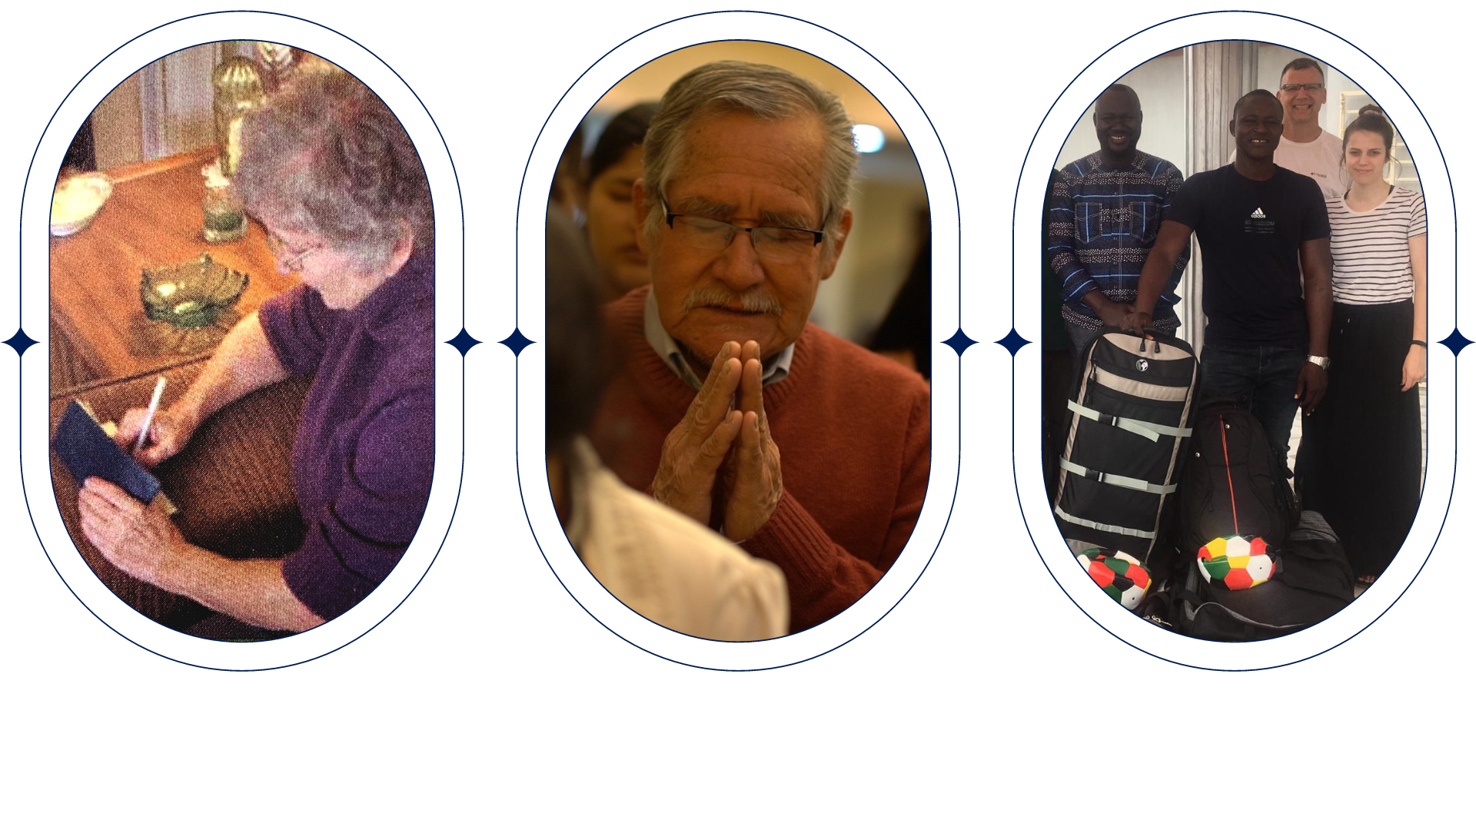



Support teams: pray – give - go
Notes:
What the teams do is so powerful: local people in their own country evangelizing to their neighbors
Because that method is so effective, what we do here is important – the teams need our support through prayer, giving, and going.

Slide 8
“Be joyful in hope, patient in affliction, faithful in prayer.”
— ROMANS 12:12 —
Notes:
Romans 12:12 says: Be joyful in hope, patient in affliction, faithful in prayer.
Prayer is so important to this ministry – Lifting up both the spiritual victories and challenges before God.
Sharing the gospel is not easy for many teams, especially in nations where Christians are persecuted for their faith.

Slide 9
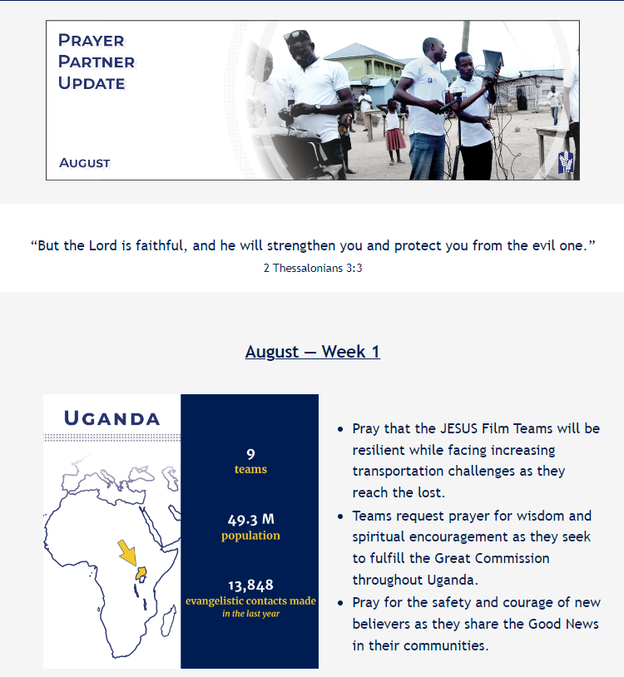
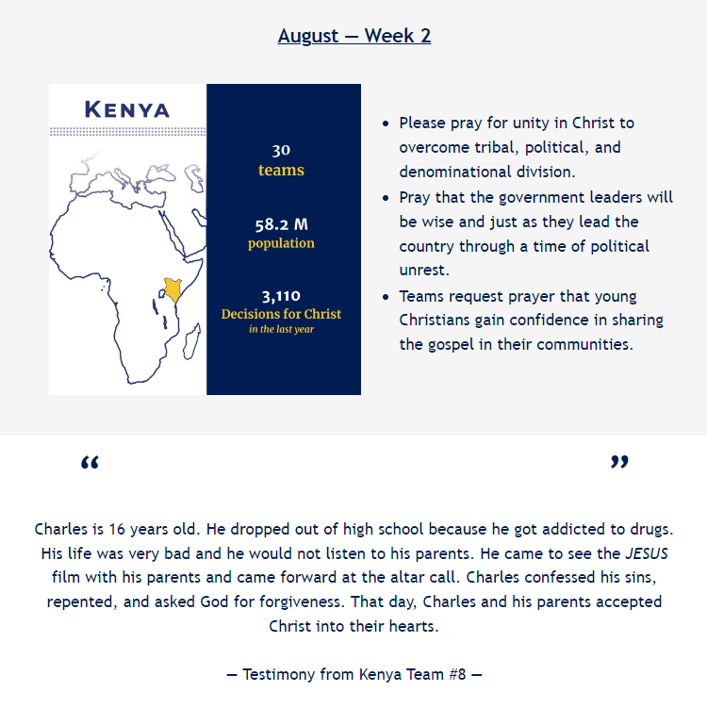
Notes:
As a prayer partner, you receive a monthly email. Here’s an excerpt from June’s Prayer Partner Update. It includes the number of teams, population, and a highlight from the teams’ reports from the last year, focusing on a different country each week.
You can also follow along with their praises and prayer requests. Each month also features an incredible testimony from one of the highlighted countries.

Slide 10

91% of JFHP funding goes to the field!
Notes:
JESUS Film teams are willing and ready to go to the hard places to share Jesus, but they need our support!
Donating to JESUS Film Harvest Partners is a great return on investment.
91% of donated dollars go to the field while the other 9% for admin and development.
You are able to be a part of lives changed in other countries without even having to leave the country!
One way you and I can support JESUS Film teams today is by providing Audio Bibles!

Slide 11
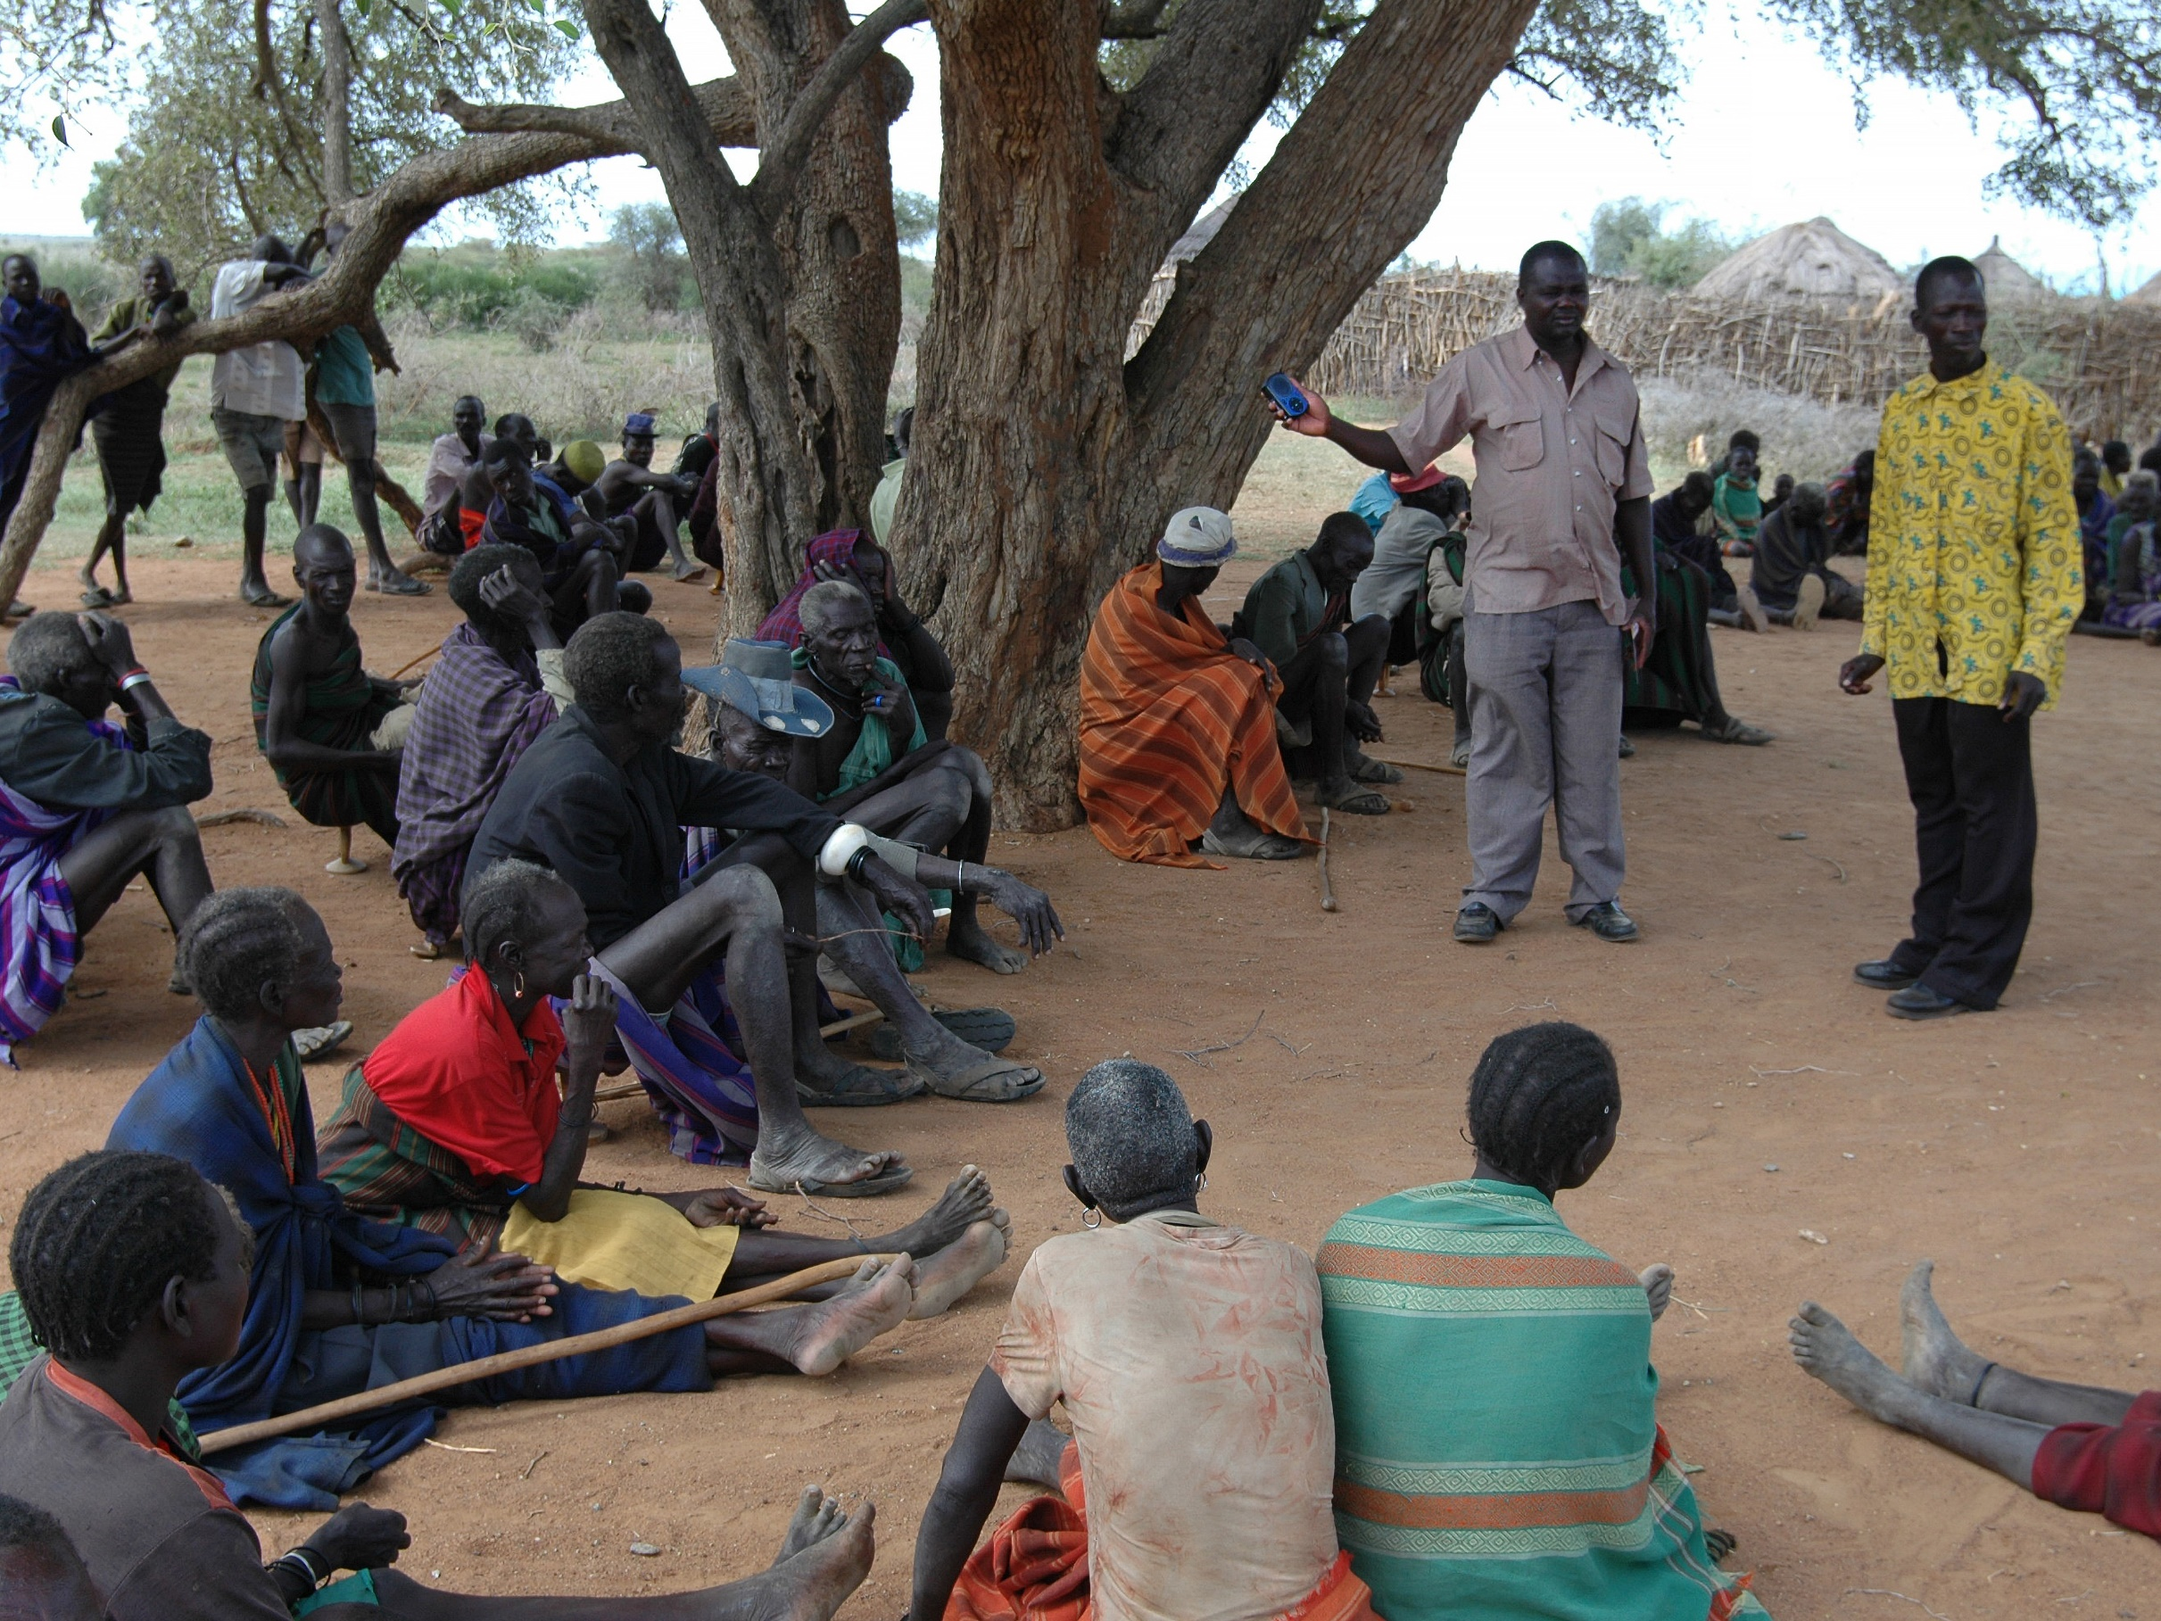
“So faith comes from hearing,
and hearing through the word of Christ.”
—Romans 10:17
Notes:
80% of the world's population learn and communicate best through oral, not textual means.
Orality tools like the Audio Bible open the doors to effective ministry with readers and non-readers alike.
Audio Bibles equip teams to disciple believers with Scripture in the listener’s heart language. These Bibles are portable, solar-powered, and can be customized to share God’s Word in more than 1,600 languages.

Slide 12
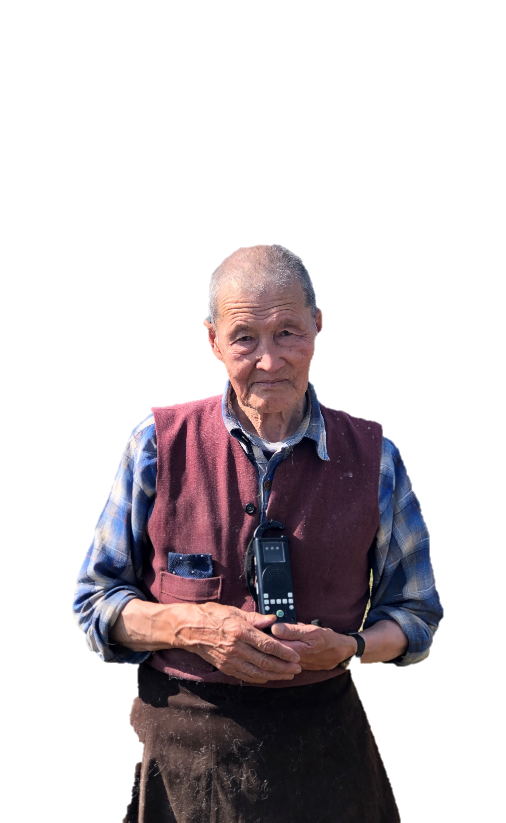
Audio Bible: $75
“…As I was listening to it, God spoke to me
through His Word!”
Notes:
For $75, you can provide an Audio Bible that will be distributed to Preaching Points, providing opportunities for more new believers to be discipled.
Here’s Yakob in South Asia’s story: “As a child, I used to go to Sunday school and memorize Bible verses with my friends, but I was a nominal Christian. I was not living according to God’s Word. Three weeks ago, two pastors visited and gave me an Audio Bible. They encouraged me to listen to it. The same night, as I was listening to it, God spoke to me through His Word! The Holy Spirit changed my life! I realized how sinful I am. I repented and accepted Jesus as my Savior. I now live for Jesus because He died for me and washed away my sins.”
Will you prayerfully consider equipping a team and partnering with God to help build the Kingdom through an Audio Bible?

Slide 13
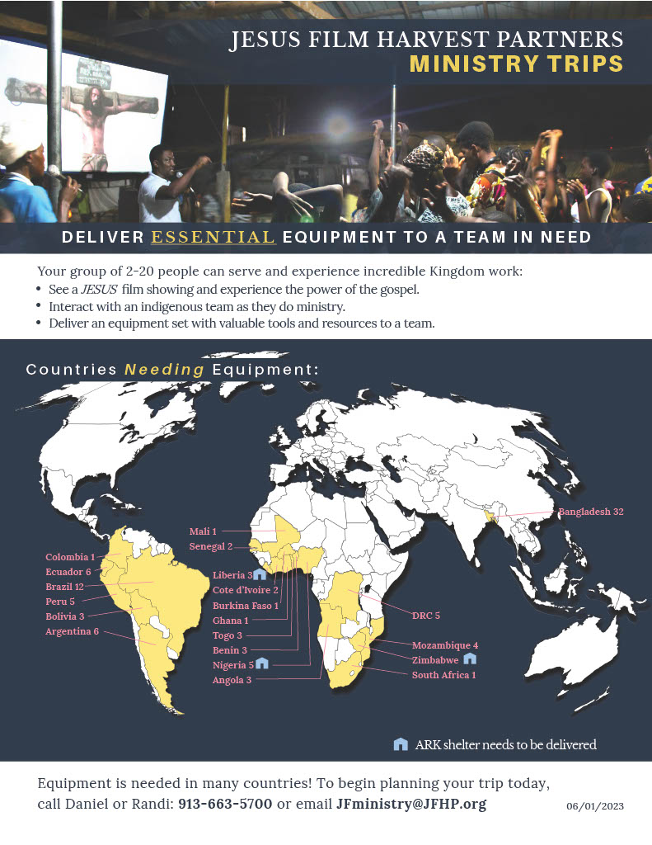
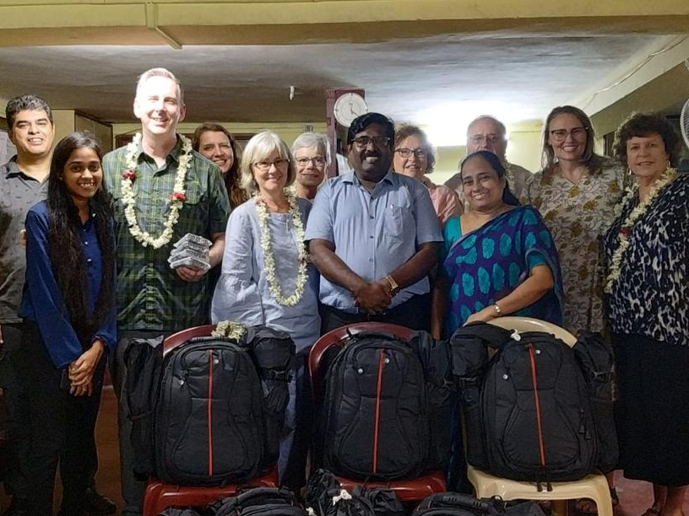
Equipment Angels
& Ministry Trips
Notes:
You can also help JFHP by going on a trip to deliver equipment to a team in need!
Equipment angels: you pick the destination and JFHP provides the equipment. We put you in contact with a leader in the field to arrange an equipment drop-off.
On a ministry trip, your church or small group raises funds for an equipment set, delivers it to a JESUS Film team, and participates in the ministry, usually for a week.
On JFHP’s website, there is a downloadable handout that is updated each month, which shows what countries need equipment, and how many teams are waiting for sets there.

Slide 14
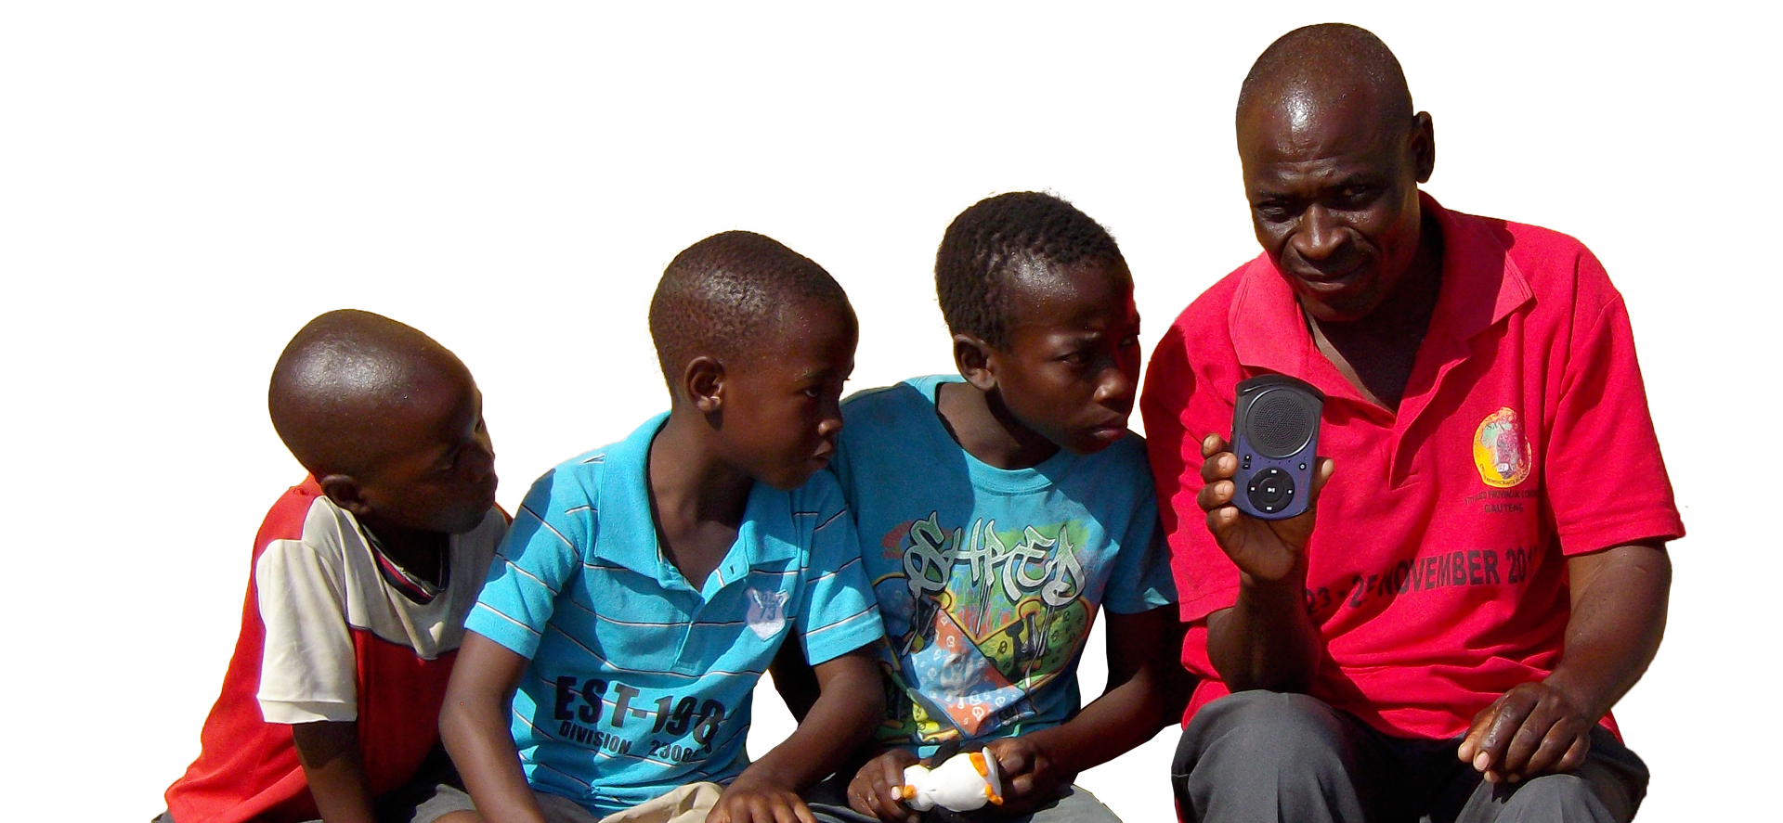
Thank you for helping
change lives for eternity!
Notes:
I hope learning how you can pray, give, and go through JESUS Film Harvest Partners has been encouraging! I believe each of us has an important part to play.
Through you as a Harvest Partner, people will come to know Jesus Christ, families will be made new, and whole villages will be transformed.
Please let me know if you have questions, and I will help you get in contact with the appropriate person at JFHP.

Slide 15



Get Involved
JFHP.org/Pray
JFHP.org/Bible
JFHP.org/Go

